Slide 1
Presentation slide template
Thank you for taking part in the
PASS Data Community Summit 2021.
Any questions?
Please email speakers@passsummit.com

Slide 2
Contents Everything you need for your presentation
3 - Slide templates
7 - Set this template as your default
9 - Icons and graphics for you to use
13 - Virtual backgrounds (optional)
16 - Slide examples

Slide 3
Slide templates Essential slides and other slide layout options

Slide 4

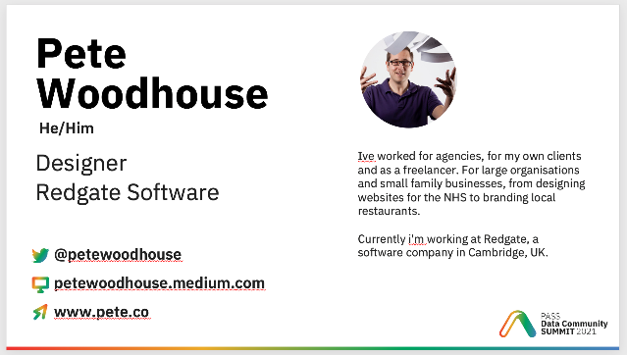

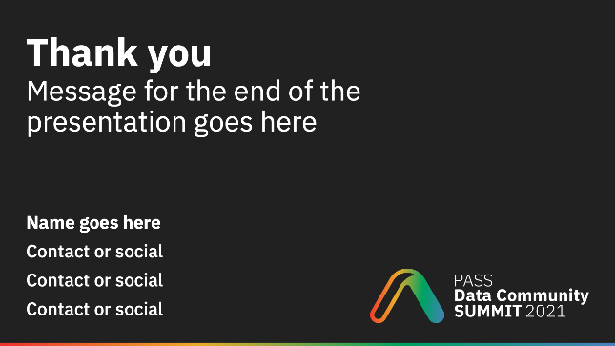
Slide templates Essential slides you must include in your presentation
Title slide
Speaker slide
Evaluation slide
Thank you slide

Slide 5
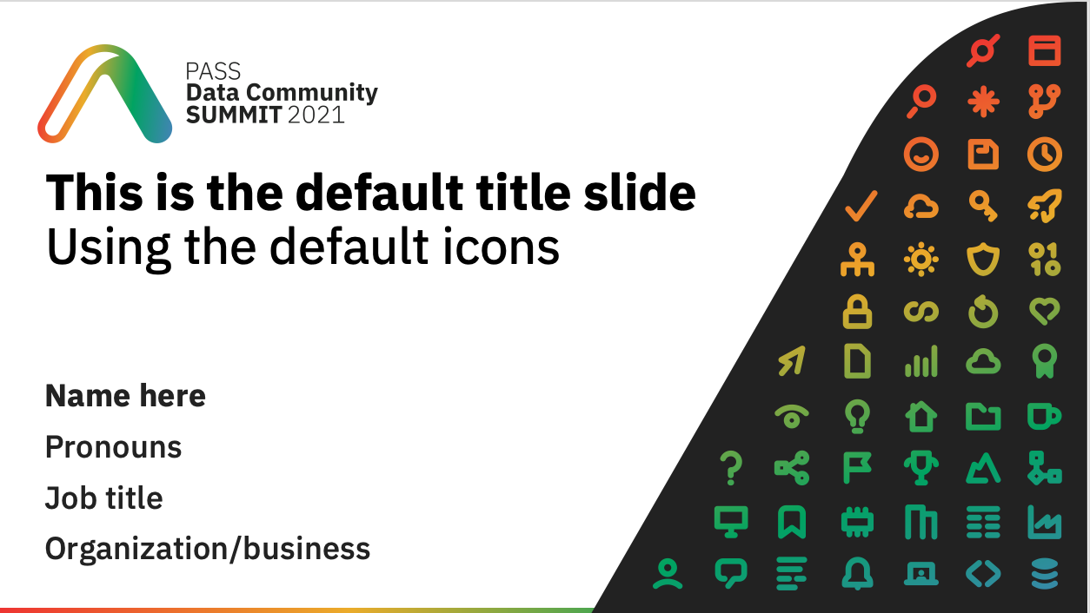


Your title slide Use the default title slide, or personalize it by adding the icons provided on page 10
Default title slide
Personalized
Personalized
Personalized
Only use the icons provided on your title slide
Avoid overlapping, distorting, or rotating the icons
Have fun and use icons that relate to your session

Slide 6
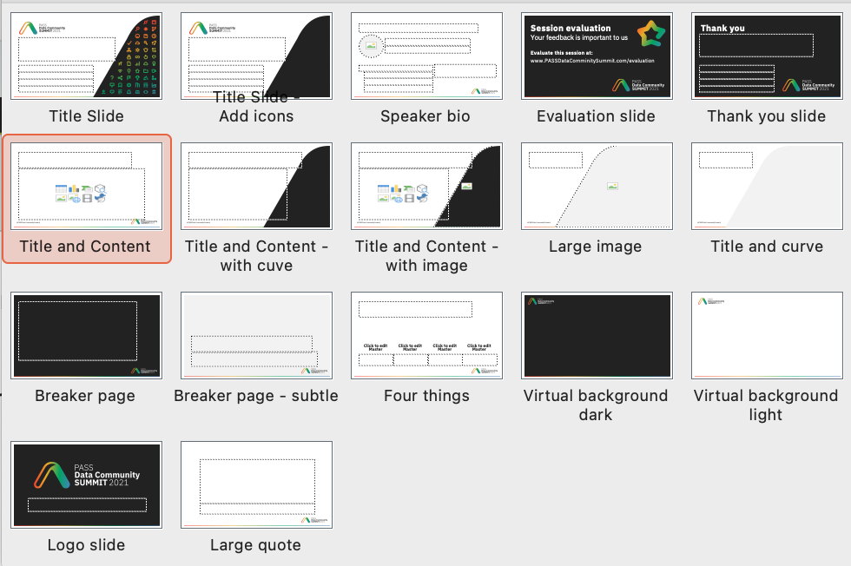
Other slide templates A variety of other slide layouts are provided

Slide 7
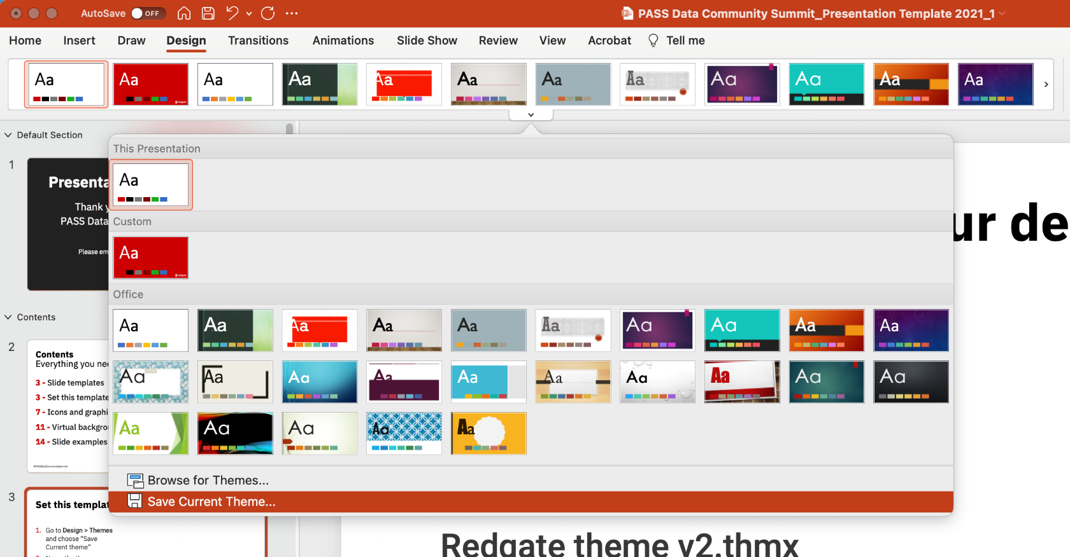
Set this template as your default
Go to Design > Themes and choose Save Current theme
Name the theme PASSSummit2021.thmx then save it
Continues on the next page

Slide 8
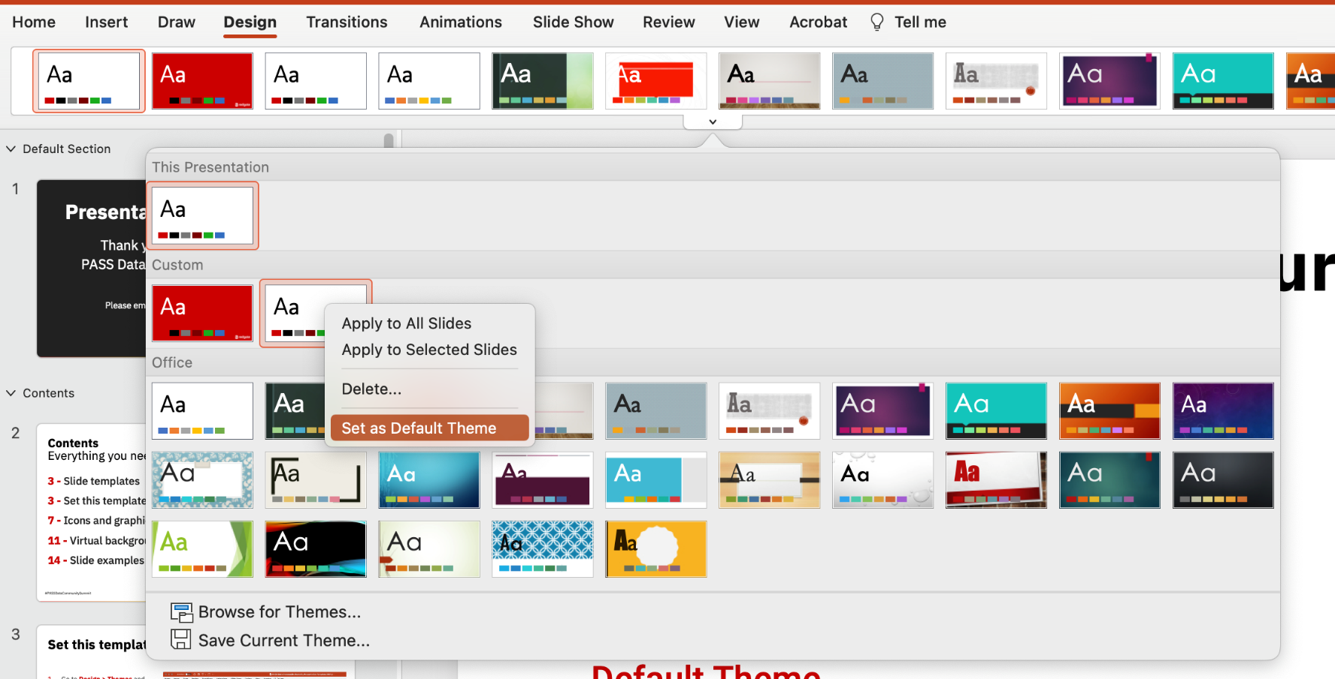
Set this template as your default
Go back to Design > Themes > Custom
Right click the theme you just saved and choose Set as Default Theme
Open a new presentation in PowerPoint, you’ll see the default PASSSummit2021 template

Slide 9
Icons and graphics You can use the provided icons and graphics throughout your presentation

Slide 10





























































Icons
A selection of icons for use in your presentations

Slide 11
Using the icons
The icons can be used big or small.
Please avoid overlapping or distorting the icons.
They can be used as bullet points
Just like they’re being used here
Keep them relevant to the point if possible

Slide 12






Other graphics you may find useful

Slide 13





Virtual backgrounds (optional) Create your own, and why not match it to your title slide

Slide 14







Virtual background examples

Slide 15
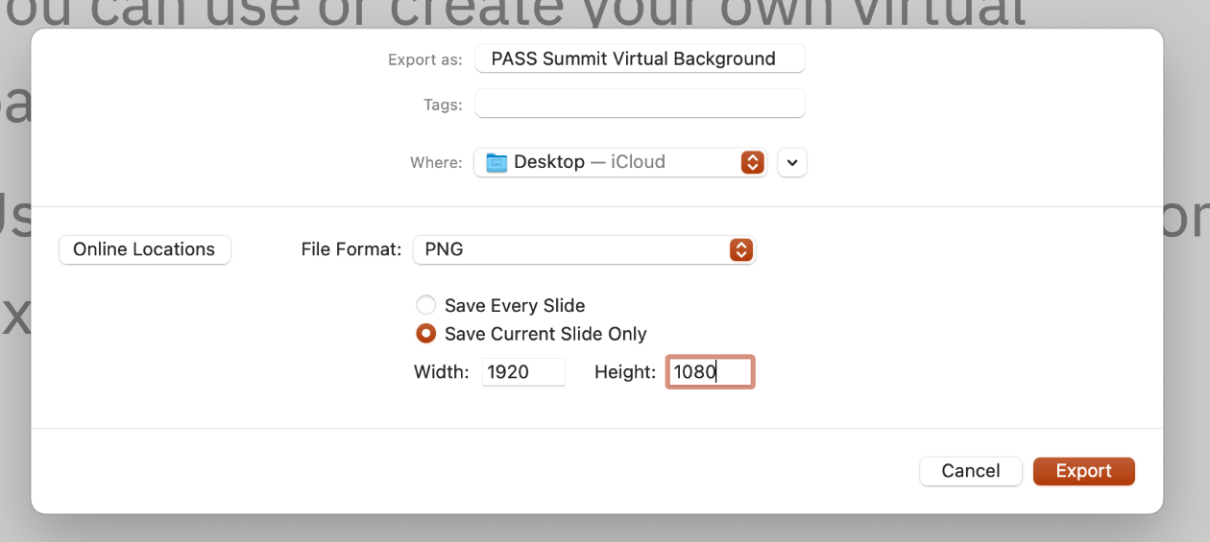
Create your own virtual background
Use the Virtual background slide layout
Add the icons from page 10
Avoid overlapping or distorting the icons
Export the slide as a png

Slide 16
Slide examples

Slide 17
Code of Conduct
The PASS Data Community Summit conference is dedicated to providing a safe and harassment-free learning and networking environment for everyone. Harassment in any form is not tolerated.
Please report any concerns
Get in touch with the organizing team at help@passsummit.com
Read our full Code of Conduct
www.PASSDataCommunitySummit.com/code-of-conduct

Slide 18
This is the default title slide Using the default icons
Name here
Pronouns
Job title
Organization/business

Slide 19
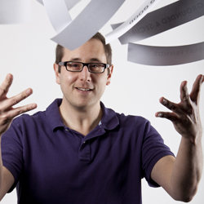
Peter
Woodhouse
He/him
Designer
I've worked for agencies, for my own clients and as a freelancer. For large organisations and small family businesses, from designing websites for the NHS to branding local restaurants. Currently I'm working at Redgate, a software company in Cambridge, UK.
Redgate Software
@petewoodhouse
Petewoodhouse.medium.com
www.pete.co

Slide 20
Message for the end of the presentation goes here
Name goes here
Contact or social
Contact or social
Contact or social

Slide 22
Why encryption isn’t enough for database development environments
Name goes here
Pronouns
Job title
Organization/business

Slide 23
Why encryption isn’t enough for database development environments
Name goes here
Pronouns
Job title
Organization/business

Slide 24
Why is Database DevOps essential for cloud migration
Name here
Pronouns
Job title
Organization/business

Slide 25
Github basics for any DBA Practical tips
Name here
Pronouns
Job title
Organization/business

Slide 26
Why the data community is at the heart of any business Fun stories & examples
Name here
Pronouns
Job title
Organization/business

